Slide 1
Retriever-Augmented Generation for Human Reference Atlas
Group 5: Rebecca Myers, Marissa Reed, Courtney Shammas

Slide 2
Problem and Motivation
https://humanatlas.io/
API: https://humanatlas.io/api
What specific problem are we solving?
Large Language Models (LLMs) struggle with domain-specific knowledge and suffer from hallucinations.
Why is it important?
Accurate and domain-specific answers are critical in biomedical research. Addressing these limitations enhances utility in complex datasets like the Human Reference Atlas (HRA).

Slide 3
Approach and Novelty
How does our approach differ or improve?
Combines Large Language Models (e.g., GPT-Neo) with external retrieval mechanisms (RAG).
Novel Ideas/Methods:
Introduced structured prompt engineering to guide accurate output.
Tailored retrieval for HRA’s hierarchical biomarker dataset.
Connected via python API to SPARQL based knowledge graph from Hubmap to pull datasets

Slide 4
Methodology
Key Methods:
Use of RAG framework to combine retrieval with generation.
Application of GPT-Neo and FIASS indexing for embedding retrieval.
Data specifics:
Hierarchical HRA biomarker dataset with 2,030 nodes.
Key attributes include parent categories (Gene, Protein, etc.) and synonym labels.

Slide 5
Challenges and Solutions
Computing Limitations
When incorporating a more customized and fine-tuned method, google colab compute units would often max out.
Human Evaluations
Since our project consisted of three members, we decided to pick a sample size of 45 when testing our two models. We each tested the model through Q&A and a ranking system
Subject Matter Expertise
For our human evaluations, we are not subject matter experts in the area of human tissue. Validation often included google searches and other methods of validation, whereas a subject matter expert may offer better expertise to rank the answers

Slide 6
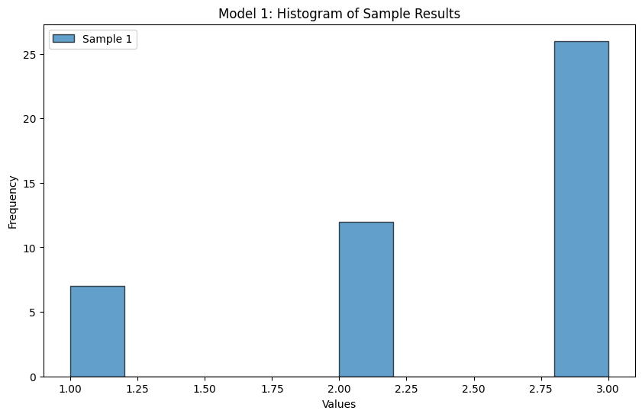
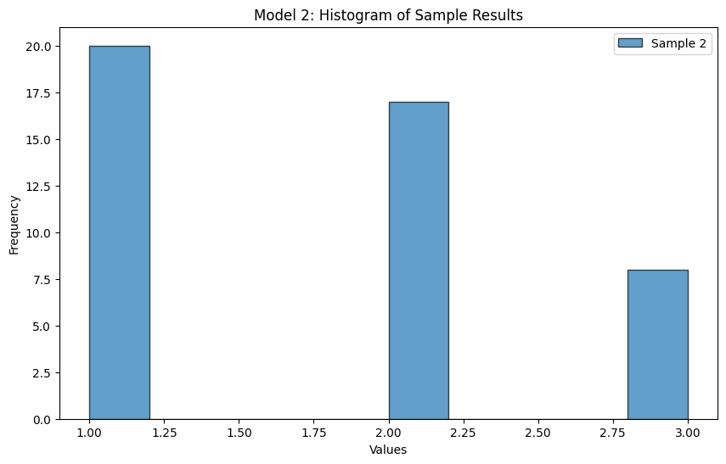
Results and Analysis
Results: Evaluation Results
Analysis: Statistical Analysis
Key Findings:
Model comparison highlighted prompt-specific performance variations.
Statistical significance shown in model outputs using Wilcoxon test.
Notes:
From the two histogram results of our evaluations, we can see an obvious difference in distribution between the two models with Model 1 outperforming 2.

Slide 7
Key Takeaways and Applications
Main Insights:
Combining RAG and tailored prompts enhances accuracy and relevance.
Structured retrieval minimizes hallucinations in domain-specific queries.
Applications:
Extendable to other domains using hierarchical datasets like the other datasets contained in the hubmap database human tissue database.
Potential in clinical decision support systems and biomedical research platforms.

